Slide 1



Slide 2
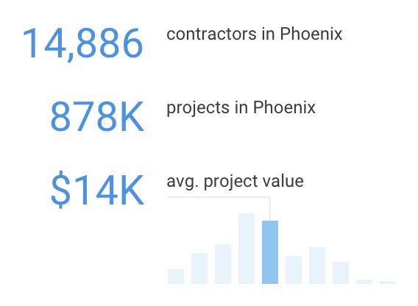
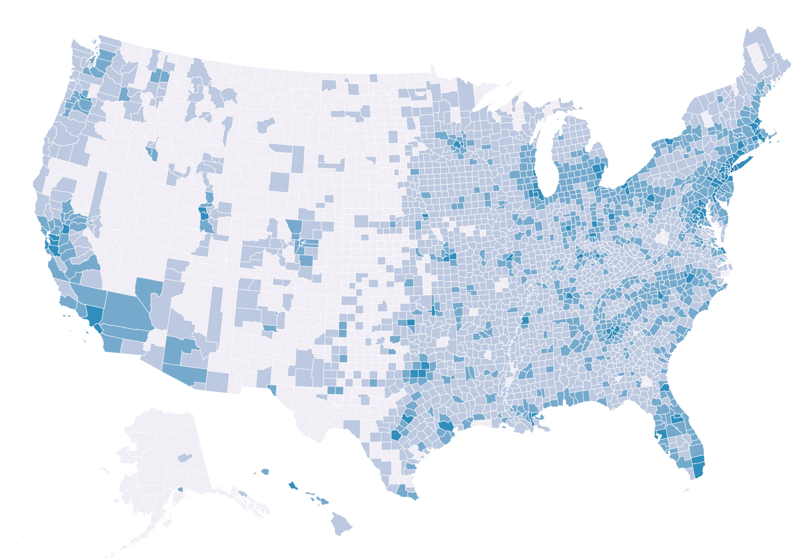
3 Million Contractors
in North America

Slide 3



Greg Hutzell
General Contractor
Gil Liebrecht
Specialty Contractor
Helena Jausas
Material Supplier
+3 million more nationwide!

Slide 4
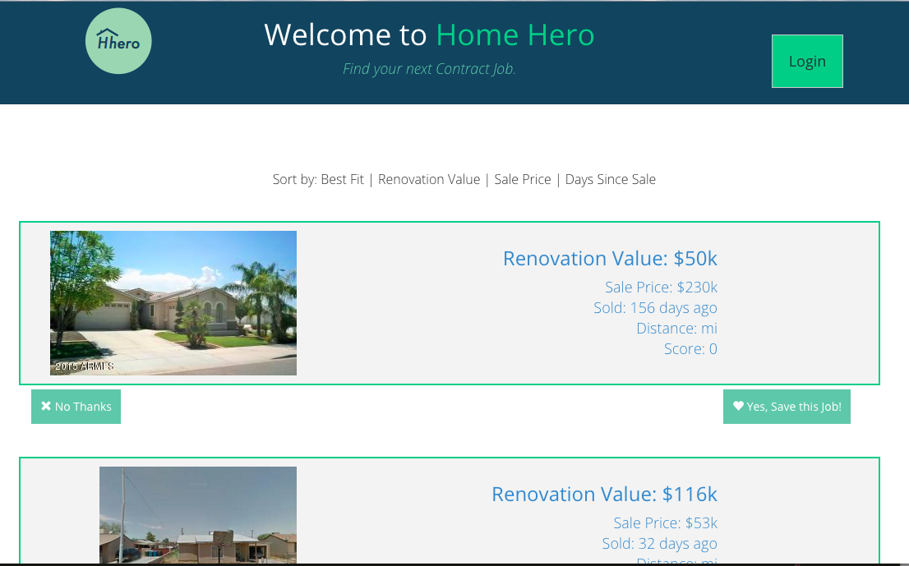
http://f51dd6bd.ngrok.io/index-login.html

Slide 5
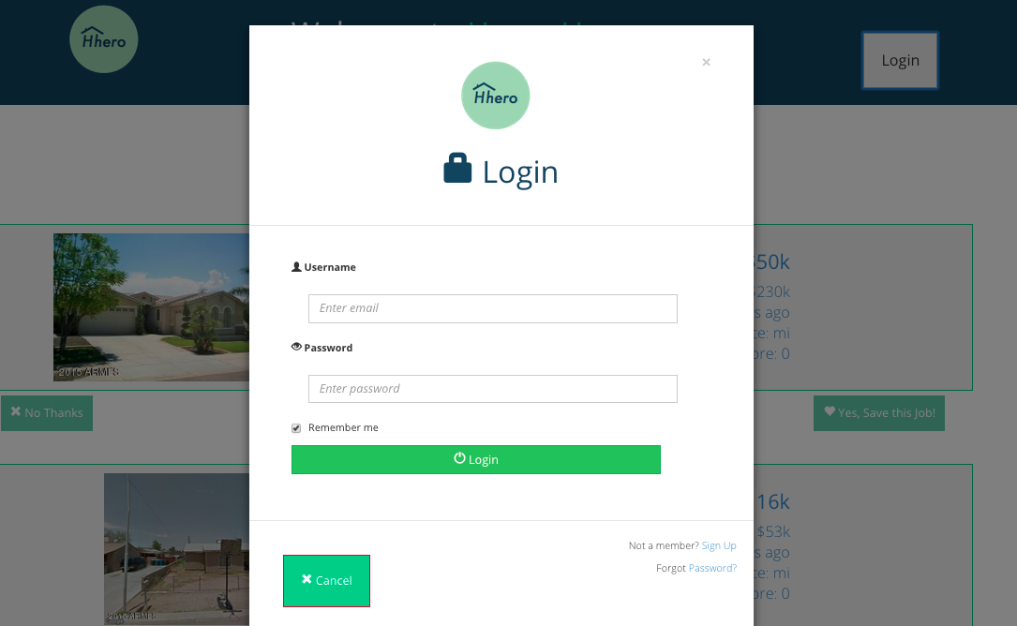

Slide 6


Slide 7
email

Slide 8
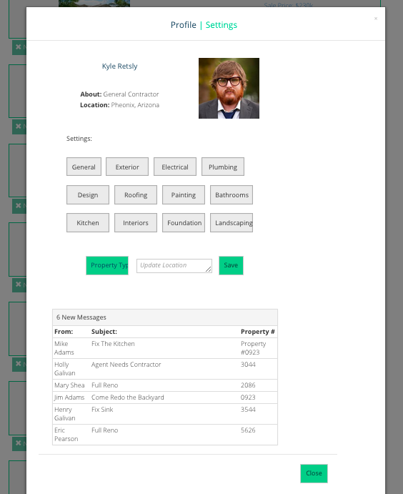

Slide 9


Slide 10






Mary Casserly
marycasserly@gmail.com
UX / Visual
Eric Crane
eric.crane10@gmail.com
Product
Simon Frid
simonfrid@gmail.com
Data
Toan Nguyen Le
toannl@gmail.com
Back End
Phil Li
philli@yahoo.com
Front End

